Slide 1

GAME PROGRAMMING IN C++
2020
Notes:
Kratak uvod u render i u to da ćemo danas da prilažemo sliku na ekranu, a posle toga pričati o teoriji renderinga

Slide 2
Game Loop
Svaka igra ima niz operacije koje se dešavaju u krug u krug i tako menjaju svoje stanje i prikazuju ga igraču
Tipičan game loop obrađuje sledeće sisteme:
Input, AI, animacije, fizika, simulacija sveta, render, zvuk, umrežavanje…
Svaka iteracija sme da traje najviše 33ms
Neki sistemi se češće obrađuju, neki ređe
Notes:
However, the rate at which these subsystems need to be serviced varies
from subsystem to subsystem. Animation typically needs to be updated at a
rate of 30 or 60 Hz, in synchronization with the rendering subsystem. How-
ever, a dynamics (physics) simulation may actually require more frequent up-
dates (e.g., 120 Hz). Higher-level systems, like AI, might only need to be
serviced once or twice per second, and they needn’t necessarily be synchro-
nized with the rendering loop at all.

Slide 3
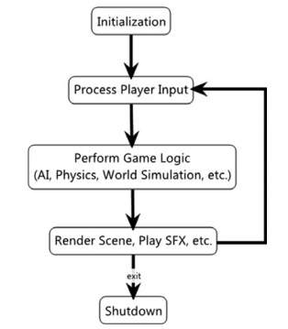
Game Loop
Mike McShaffry and David Graham. 2012. Game Coding Complete (4th. ed.). Delmar Learning.
Notes:
The easiest way to create a main loop is to simply update every system once each
frame, as shown in Figure 7.1.
This is the easiest method to actually write since all you need to do is directly call a
bunch of update functions, but it tends to be very inflexible. What happens if you
want the AI to update at a different frequency?
Conversely, you’ll want to render as quickly
as humanly possible to avoid hitches in the visual presentation of the game.
As inflexible as this method is, it’s still certainly valid. Early games from the Stone
Age (for example, the late 80s and early 90s) all used this method. Some games still
do.

Slide 4
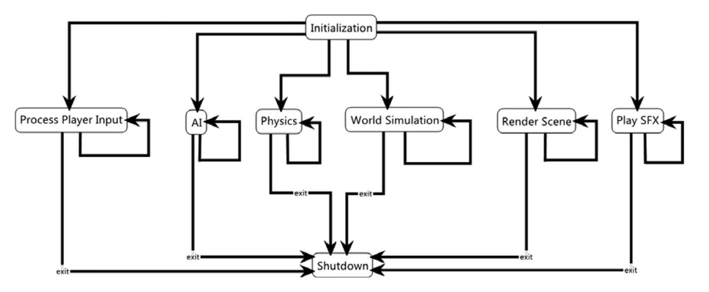
Game Loop
Mike McShaffry and David Graham. 2012. Game Coding Complete (4th. ed.). Delmar Learning.
Notes:
One problem with using a multithreaded architecture is communication between
threads. When you have multiple threads all running at the same time and trying to
communicate with each other, you have to take steps to ensure thread safety. Fur-
thermore, threads tend to be pretty heavyweight objects, so it’s inefficient to use
threads for everything.

Slide 5
Game Loop + Operativni Sistem
Windows podržava multitasking – moramo da naučimo da se slažemo sa Windowsom i ostalim aplikacijama koje se izvršavaju u isto vreme kad i naša
Windows aplikacije su event-driven
Operativni sistem komunicira sa aplikacijom porukama na koje aplikacija mora da reaguje
Window procedure - svaki prozor ima posebnu funkciju koja obrađuje ove poruke
Nama SDL daje wrapper za to
Tipovi poruka:
Stvaranje prozora, pomeranje miša, pritisak dugmeta na tastaturi, pomeranje prozora, menjanje veličine prozora, ulazak miša u prozor, izlazak miša iz prozora, cut, copy, paste, dobijanje i gubljenje fokusa…
Lista svih poruka
Notes:
For a PC game engine, you also need code to integrate your renderer with
the Windows message loop. You typically write a “message pump” that ser-
vices Windows messages when they are pending and otherwise runs your ren-
der loop over and over as fast as it can. This ties the game’s keyboard polling
loop to the renderer’s screen update loop. This coupling is undesirable, but
with some effort it is possible to minimize the dependencies. We’ll explore
this topic in more depth later
On a Windows platform, games need to service messages from the Windows
operating system in addition to servicing the various subsystems in the game
engine itself. Windows games therefore contain a chunk of code known as a
message pump. The basic idea is to service Windows messages whenever they
arrive and to service the game engine only when no Windows messages are
pending.
Another problem with working on a multitasking platform like Windows is that you
sometimes have to yield resources to those applications. For example, games typically
acquire exclusive access to system resources like the video card, which allows them to
render in full screen at custom resolutions. If the user Alt-tabs, you will lose that
exclusive control and need to be able to handle that situation.

Slide 6


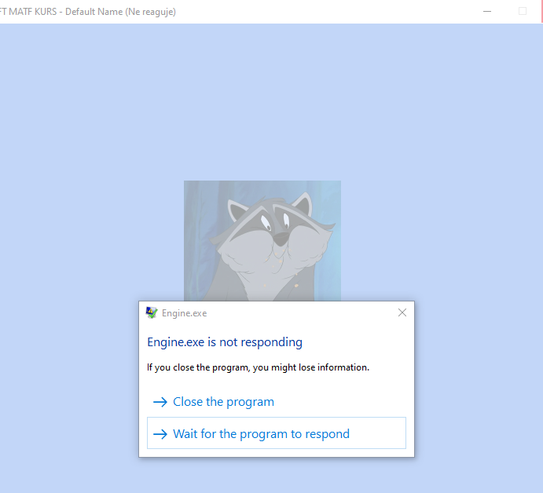
Windows Message Loop
Ukoliko aplikacija ne reaguje na poruke
Notes:
If a top-level window stops responding to messages for more than several seconds, the system considers the window to be not responding. In this case, the system hides the window and replaces it with a ghost window that has the same Z order, location, size, and visual attributes. This allows the user to move it, resize it, or even close the application. However, these are the only actions available because the application is actually not responding. When in the debugger mode, the system does not generate a ghost window.

Slide 7
Windows Message Loop
Windows dokumentacija nam pomaže da napišemo kod za Message Loop
// WARNING: Don't actually write your loop this way.
MSG msg = { }; while (1)
{
GetMessage(&msg, NULL, 0, 0);
TranslateMessage(&msg);
DispatchMessage(&msg);
}
This function removes the first message from the head of the queue. If the queue is empty, the function blocks until another message is queued.
The TranslateMessage function is related to keyboard input. It translates keystrokes (key down, key up) into characters. You do not really have to know how this function works; just remember to call it before DispatchMessage.
The DispatchMessage function tells the operating system to call the window procedure of the window that is the target of the message. In other words, the operating system looks up the window handle in its table of windows, finds the function pointer associated with the window, and invokes the function.
Notes:
Ovo nam i dalje ne omogućava da izađemo iz aplikacije ikad. Ona neće reagovati na klik na X

Slide 8
Windows Message Loop
Windows dokumentacija nam pomaže da napišemo kod za Message Loop
MSG msg = { };
while (PeekMessage(&msg, hwnd, 0, 0, PM_REMOVE))
{
TranslateMessage(&msg);
DispatchMessage(&msg);
}
PeekMessage is similar to the GetMessage function; both check a message queue for a message that matches the filter criteria and then copy the message to an MSG structure. The main difference between the two functions is that GetMessage does not return until a message matching the filter criteria is placed in the queue, whereas PeekMessage returns immediately regardless of whether a message is in the queue.
Notes:
The PostQuitMessage function puts a WM_QUIT message on the message queue. WM_QUIT is a special message: It causes GetMessage to return zero, signaling the end of the message loop. Here is the revised message loop.
As long as GetMessage returns a nonzero value, the expression in the while loop evaluates to true. After you call PostQuitMessage, the expression becomes false and the program breaks out of the loop. (One interesting result of this behavior is that your window procedure never receives a WM_QUIT message. Therefore, you do not have to have a case statement for this message in your window procedure.)

Slide 9
SDL Message Loop
LazyFoo SDL tutorial nam pomaže da napišemo kod za Message Loop
SDL_Event e;
while (SDL_PollEvent( &e ) != 0)
{
TranslateMessage(&msg);
DispatchMessage(&msg);
}
Notes:
Ovo nam i dalje ne omogućava da izađemo iz aplikacije ikad. Ona neće reagovati na klik na X

Slide 10
SDL Message Loop - Zadatak
Uspešno izaći iz igre ¯\_(ツ)_/¯
Naš main loop je u Engine::Application::Run()
Zameniti while(true) petlju sa SDL_PollEvent petljom
Reagovati na SDL_Quit u petlji
Hint: http://lazyfoo.net/tutorials/SDL/03_event_driven_programming/index.php

Slide 11
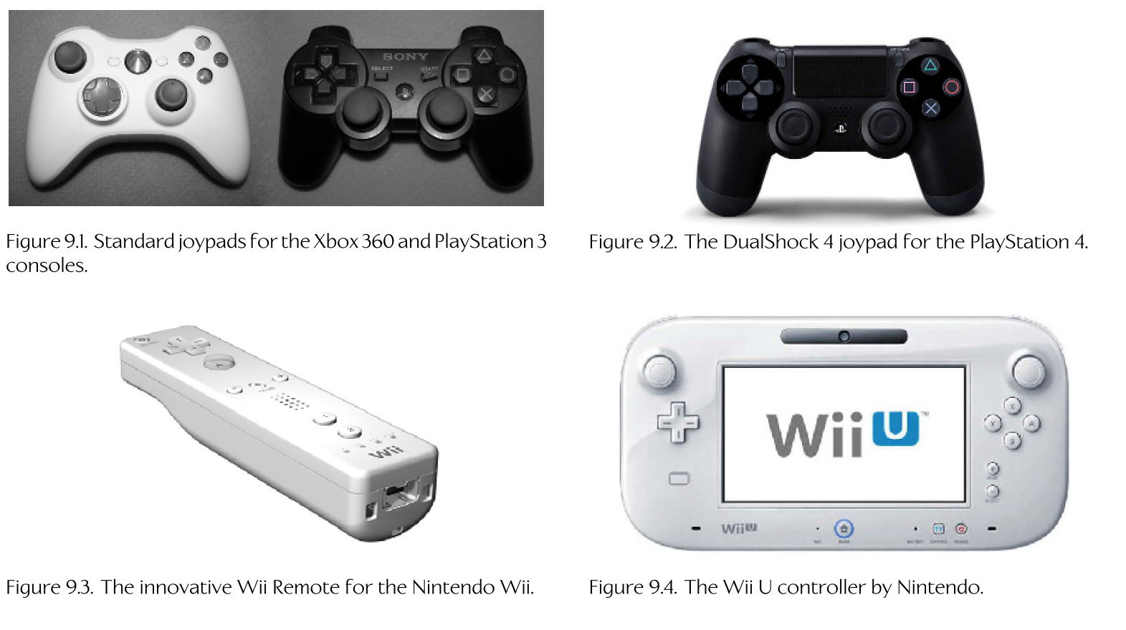
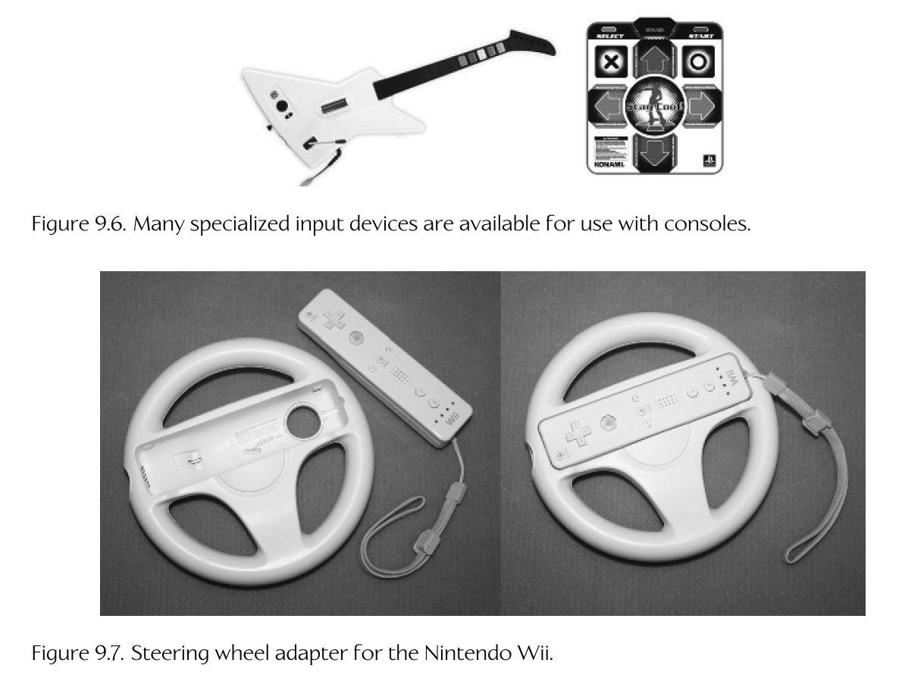
Input uređaji
Jason Gregory. 2019. Game Engine Architecture
Notes:
+ Arcade stick, touch screen, kamere (Wii), volani, Tobii

Slide 12
Input uređaji – osnovne komponente
Digitalni
Dugme – pritisnuto, nije pritisnuto
Analogni
1-, 2-, 3-axis
Apsolutne vs relativne koordinate
Dead Zones
Sensitivity
Kamere
Svi moderni input uređaji su kombinacija ovih komponenti
Notes:
Although human interface devices for games vary widely in terms of form fac-
tor and layout, most of the inputs they provide fall into one of a small number
of categories. We’ll investigate each category in depth below.
Strictly speaking, analog inputs are not really analog by the time they make
it to the game engine. An analog input signal is usually digitized, meaning it
is quantized and represented using an integer in software.
The position of an analog button, trigger, joystick or thumb stick is absolute,
meaning that there is a clear understanding of where zero lies. However, the
inputs of some devices are relative. For these devices, there is no clear location
at which the input value should be zero. Instead, a zero input indicates that
the position of the device has not changed, while nonzero values represent
a delta from the last time the input value was read. Examples include mice,
mouse wheels and track balls.

Slide 13
Input uređaji – low level
Polling
Aplikacija uzima stanje direktno od uređaja kad joj zatreba i reaguje na promene
Manje kašnjenje, ali je moguće propustiti neke inpute
Windows: GetAsyncKeyState() , DIrectInput: IDirectInputDevice::GetDeviceState()
Interrupts / Callbacks
Uređaji javljaju operativnom sistemu svoje stanje, a aplikacija reaguje na ove promene kad joj je zgodno
Wireless uređaji
Često u posebnom threadu održavaju wireless komunikaciju
Sistemi igre ne treba da reaguju direktno na hardverske događaje
Notes:
There’s a Windows function that will return the status of any key. It’s tempting to
use, especially given the morass of weirdness you have to deal with going a more tra-
ditional route with Windows keyboard messages. Unfortunately, there’s a dark side to
these functions and other functions that poll the state of device hardware outside of
the message loop.
Most testing scripts or replay features pump recorded messages into the normal mes-
sage pump, making sure that actual hardware messages are shunted away. Polling
functions like GetAsyncKeyState() aren’t easily trapped in the same way. They
also make debugging and testing more difficult, since timing of keyboard input
could be crucial to re-creating a weird bug.

Slide 14
Input uređaji – high level
Detekcija pritiska i puštanja dugmeta
Detekcija više pritisnutih dugmića odjednom
Detekcija dugog držanja dugmeta
Input action -> Input Mapping -> Input remapping
Input context
Local multiplayer
Notes:
Correct and smooth handling of human interface devices is an important part
of any good game. Conceptually speaking, HIDs may seem quite straightfor-
ward. However, there can be quite a few “gotchas” to deal with, including
variations between different physical input devices, proper implementation
of low-pass fi ltering, bug-free handling of control scheme mappings, achiev-
ing just the right “feel” in your joypad rumble, limitations imposed by console
manufacturers via their technical requirements checklists (TRCs), and the list
goes on.
If you follow a modular design, your game objects can be controlled via the same
interface, whether the source of that control is a gamepad or an AI character. For
example, the AI character could send commands like “brake 75%” or “steer 45%”
into a car controller, where the human player touches a few gamepad keys, generating
translated events that eventually result in exactly the same calls but to a different car.

Slide 15
Primer arhitekture input sistema
Button
Input Manager
Input Action
Input Context
Notes:
Primer Input sistema:
- Sistemski nivo: Proveravaju se svi dugmići da li su pritisnuti i smeštaju se u niz. IDirectInputDevice::GetDeviceState()
- Engine nivo: Stack input contexta u input manageru i onda prolazi kroz svaki redom i kroz svaku akciju i proverava da li je akcija aktivna ili ne. Akcije mogu biti aktivirane na klik dugmeta, držanje dugmeta, određeni pomeraj i smer joysticka ili položaj objekta u prostoru (igrača – Kinect, kontrolera – Wii) ili da vraćaju neku „analognu“ vrednost. Input context može biti blokirajući, u kom slučaju se prestaje sa proverom donjih contexta. Ovo je neoptimalno jer nam ne trebaju sve akcije u svakom frejmu, tako da može da se optimizuje da se proverava status akcije samo kad nam zatreba i da se onda kešira njena vrednost.
Delovi ovog sistema mogu da budu pojednostavljeni, ukoliko nam ne treba input context ili, naravno, proširivani do besvesti.
Primer: Input remapping, gde se iz menija tokom igre ili iz pre pokretanja iz nekog (recimo xml) fajla čita koje dugme aktivira koju akciju.
Streaming – input latency izaziva razne probleme, koji se usložnjavanjem ovog sistema mogu donekle izbeći (slanje timestampa uz pritisnuto dugme)

Slide 16
Naša arhitektura
Nećemo koristiti InputContext
Slobodni ste da ih dodajete ili ćemo to zajedno uraditi ako nam ostane vremena na kraju kursa
SDL_PollEvent() vs GetAsyncKeyState()

Slide 17
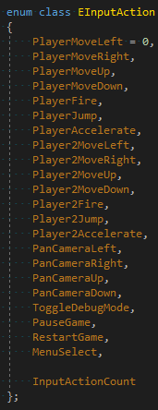
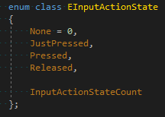
Naša arhitektura

Slide 18
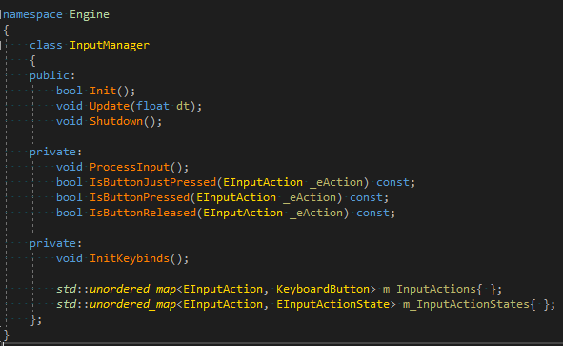
Naša arhitektura
Notes:
Implementacije svih ovih funkcija su u cpp fajlu
Dodajemo instancu klase InputManager u Application, dodajemo i Update (nećemo koristiti dt),

Slide 19
Input sistem - Zadatak
Popuniti Switch-Case u InputManager::ProcessInput()

